Slide 1
Discrete Mathematics
Chapter 10
Binary Trees
Book: Schaum’s Outlines

Slide 2
Binary Trees
Some of the terminology, such as edge, path, branch, leaf, depth and level number, will be used for binary trees.
We will use the term node, with binary tree.
In binary tree, every node has at most 2 children.

Slide 3
Binary Trees
A binary tree T is defined as a finite set of elements, called nodes, such that:
T is empty (called the null tree or empty tree) or
T contains a distinguished node R, called the root of T, and the remaining nodes of T form an ordered pair of disjoint binary trees T₁ and T₂.

Slide 4
Binary Trees
If T does contain a root R, then the two trees T₁ and T₂ are called, respectively, the left and right subtrees of R.
If T₁ is nonempty, then its root is called the left successor of R.
If T₂ is nonempty, then its root is called the right successor of R.
A node with no successors is called a terminal node.

Slide 5
Picture of a Binary Tree
A binary tree T is frequently presented by a diagram in the plane called a picture of T. Specifically, the diagram represents a binary tree as follows:
T consists of 11 nodes, represented by the letters A through L, excluding I.
The root of T is the node A at the top of the diagram.

Slide 6
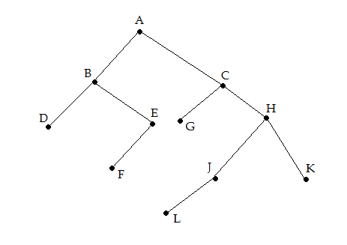
Picture of a Binary Tree
(a) B is a left successor and C is a right successor of the root A.

Slide 7
Picture of a Binary Tree
(b) The left subtree of the root A consists of the nodes B,D,E and F, and the right subtree of consists of the nodes C,G,H,J,K and L.
(c) The nodes A,B,C and H have two successors.
The nodes E and J have only one successor.
The nodes D,F,G,L and K have no successors, i.e; they are terminal nodes.

Slide 8
Similar Binary Trees
Binary trees T and T’ are said to be similar if
They have the same structure or, in other words
If they have the same shape.

Slide 9
Copies Binary Trees
Binary trees T and T’ are said to be copies if
They are similar and
They have the same contents as corresponding nodes.

Slide 10
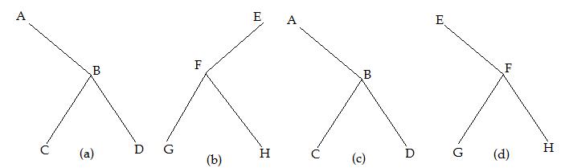
Similar and Copies Binary Trees
The three trees (a),(c) and (d) are similar.
In particular the trees (a) and (c) are copies since they also have the same data at corresponding nodes.
The tree (b) is neither similar nor a copy of (d) , because, in a binary tree, we distinguish between a left successor and a right successor.

Slide 11
Algebraic Expressions
Consider any algebraic expression E involving only binary operations, such as:
E=(a-b)/((c*d)+e)
E can be represented by means of the binary tree T.

Slide 12
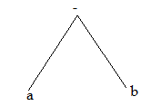
Algebraic Expressions
E=(a-b)

Slide 13
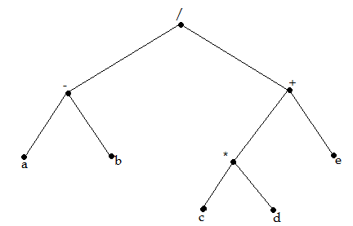
Algebraic Expressions
E=(a-b)/((c*d)+e)

Slide 14
Algebraic Expressions
Draw the binary tree for the following algebraic expression:
E=((a+b)*(d-e))/((c*d)+(w-q))

Slide 15
Terminology
Suppose N is a node in T with left successor S₁ and right successor S₂.
Then N is called the parent (or father) of S₁ and S₂.
S₁ is called the left child (or son) of N and S₂ is called the right child (or son) of N.
S₁ and S₂ are said to be siblings (or brothers).
Every node N in a binary tree T, except the root, has a unique parent, called the predecessor of N.

Slide 16
Complete Binary Trees
Consider any binary tree T.
Each node of T can have at most two children.
One can show that level r of T can have at most 2^{r} nodes.

Slide 17
Complete Binary Trees
The tree T is said to be complete if
All its levels, except possibly the last, have the maximum number of possible nodes, and
All nodes at the last level as far left as possible.
Thus there is a unique complete tree T_{n} with exactly n nodes.

Slide 18
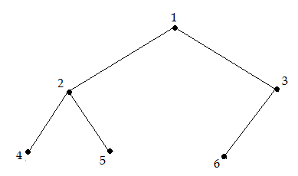
Complete Binary Trees
The complete tree T₆ with 6 nodes appears in the following:
Draw the complete tree T_{14.}

Slide 19
Complete Binary Trees
Labelling is done by the integers 1,….,n for T_{n}.
With this labelling, one can easily determine the children and parent of any node K in any complete tree T_{n}.
Specifically, the left and right children of node K are, respectively 2*K and 2*K+1
The parent of K is the node [K/2].

Slide 20
Complete Binary Trees
For example:
The children of node 9 for T₂₆ are the nodes 18 and 19.
Its parent is the node [9/2]=4.
The depth d_{n} of the complete binary tree T_{n} with n nodes is given by,

Slide 21
Complete Binary Trees
If the complete binary tree T_{n} has n=1000000 nodes, then its depth, d_{n}=21.

Slide 22
Extended Binary Trees
A binary tree T is said to be a 2-tree or an extended binary tree if each node N has either 0 or 2 children.
In such a case, the nodes with 2 children are called internal nodes and the nodes with 0 children are called external nodes.

Slide 23
Extended Binary Trees
Nodes are distinguished by using circles for internal nodes and squares for external nodes.
Consider any binary tree T. T can be converted into a 2-tree by replacing each empty subtree by a new node.
Observe that, the nodes in the original tree T are now the internal nodes in the extended tree and the new nodes are external nodes in the extended tree.

Slide 24
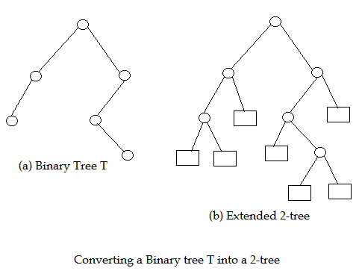
Extended Binary Trees

Slide 25
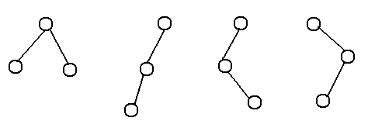
Extended Binary Trees
What are the extended binary trees of the following binary trees?

Slide 26
Traversing Binary Trees
There are three standard ways of traversing a binary tree T with root R. These algorithms are called
Preorder
Inorder
Postorder

Slide 27
Preorder
The algorithm of preorder is the following:
Process the root R
Traverse the left subtree of R in preorder
Traverse the right subtree of R in preorder

Slide 28
Preorder
The preorder traversal is as follows:
A B D E F C G H J L K

Slide 29
Inorder
The algorithm of inorder is the following:
Traverse the left subtree of R in inorder
Process the root R
Traverse the right subtree of R in inorder

Slide 30
Inorder
The inorder traversal is as follows:
D B F E A G C L J H K

Slide 31
Postorder
The algorithm of postorder is the following:
Traverse the left subtree of R in preorder
Traverse the right subtree of R in preorder
Process the root R

Slide 32
Postorder
The inorder traversal is as follows:
D F E B G L J K H C A

Slide 33
Traversing Example
Find out : preorder, inorder and postorder traversal.

